Slide 1
Data Analysis
The Online Shoppers Intention Dataset

Slide 2
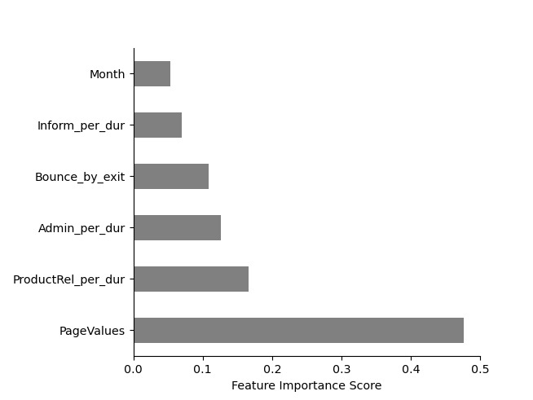
Feature Importance

Slide 3
Counts Of Revenue Generated

Slide 4
Page Values Over the Year

Slide 5
Shoppers Over the Year

Slide 6
Percentage Of Visitors

Slide 7
Revenue Generated

Slide 8
Shoppers Spread Over the Regions

Slide 9
Key Points
42.74% of the Revenue was generated in Summer Vacation and about 38.32% of the Revenue generated in Winter Vacation
Though Shoppers visited the site more in Winter Vacation, the higher revenue was generated in the summer
Over 86% of the Customers visited the site, related to the Products, rest of the percentage was related to the Information and Administrative.
According to the data, 85% of the Customers are loyal to the service that are provided by the company.

Slide 10
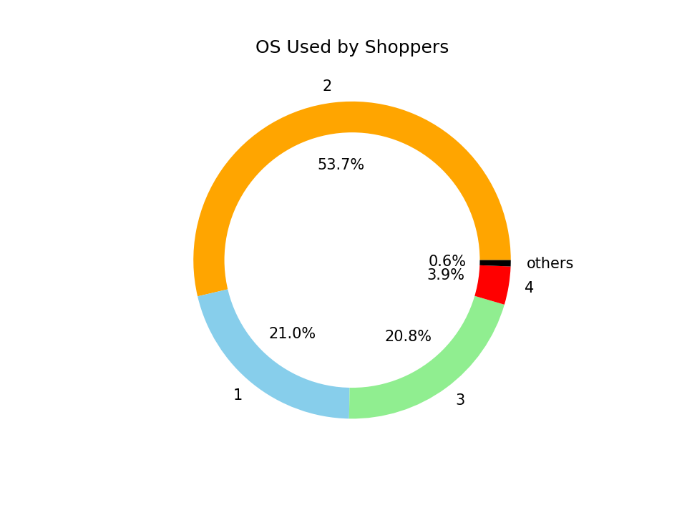

Slide 11
Browsers Vs OS

Slide 12
Thank you

